Slide 1
RRH DAILY PASS
June 26, 2020

Slide 2
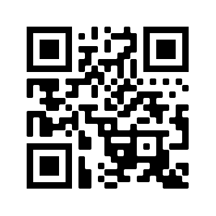
RRH DAILY PASS USER GUIDE
HOW TO ACCESS:
1. Scan QR Code with your mobile phone or enter www.rrhdailypass.org into your browser.
Note: We recommend you bookmark rrhdailypass.org for quick access in your mobile phone or desktop browser.

Slide 3
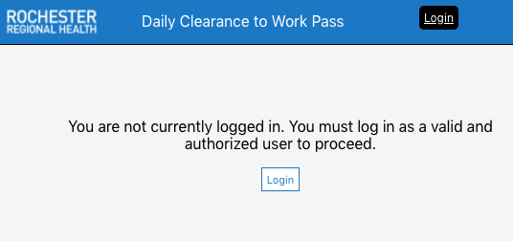
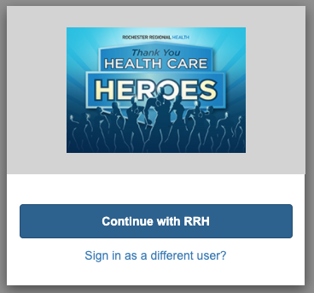
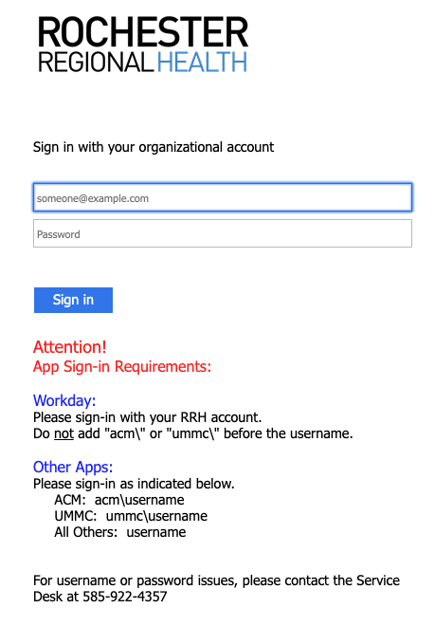
RRH DAILY PASS USER GUIDE
HOW TO LOGIN:
1. Click Login
2. Click RRH
3. Enter Credentials
Students: Login using your Care Connect username and password.
DO NOT LOGIN WITH YOUR EMAIL ADDRESS USE YOUR USERNAME.
User name may default to username@viahhealth which is normal.

Slide 4
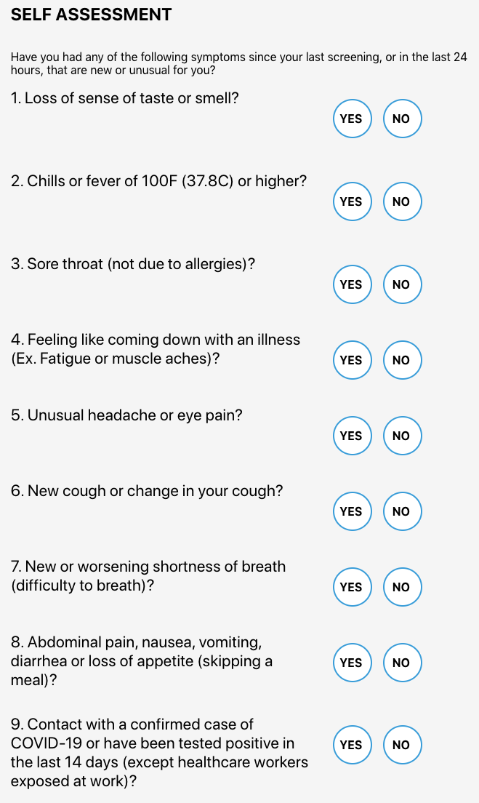
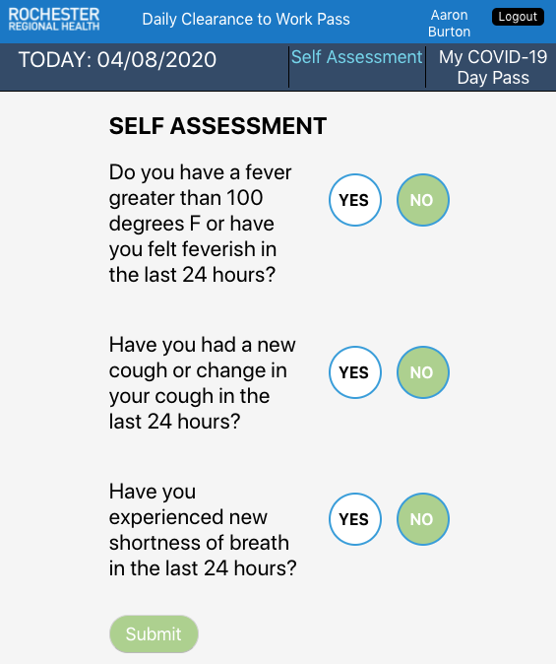
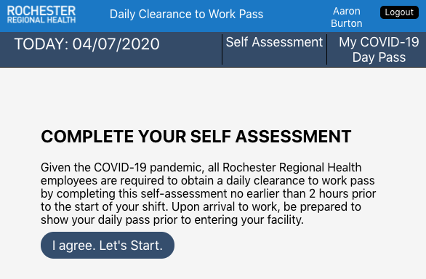
RRH DAILY PASS USER GUIDE
HOW TO USE:
After you login, you will reach the homepage as shown below.
2. Complete Self Assessment and click submit.
1. Click I agree. Let’s Start.
Larger View

Slide 5
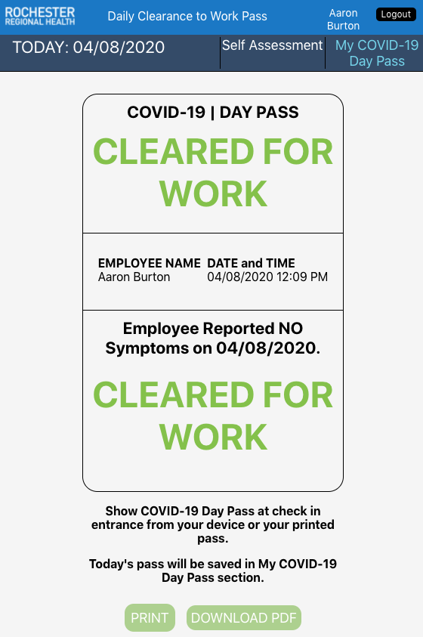
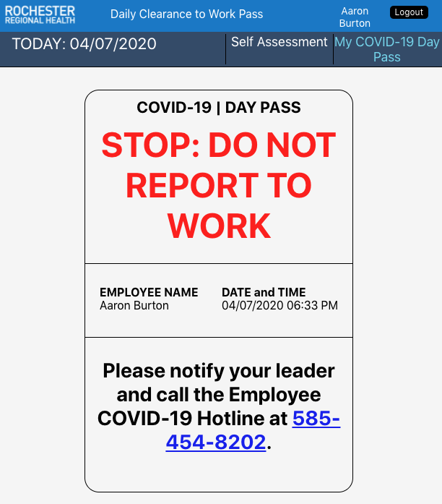
RRH DAILY PASS USER GUIDE
HOW TO USE:
After you click SUBMIT, you will you receive a CLEARED FOR WORK PASS or DO NOT REPORT TO WORK MESSAGE & INSTRUCTIONS
NOTE: Your pass for the day will be saved in your
My COVID-19 DAY PASS section.
At anytime during the 24 hour period, you can go to RRHDAILYPASS.ORG and click on My COVID-19 DAY Pass to retrieve that day’s pass.
You can also print your CLEARED FOR WORK PASS by clicking the print button or download by clicking on Download PDF.

Slide 6
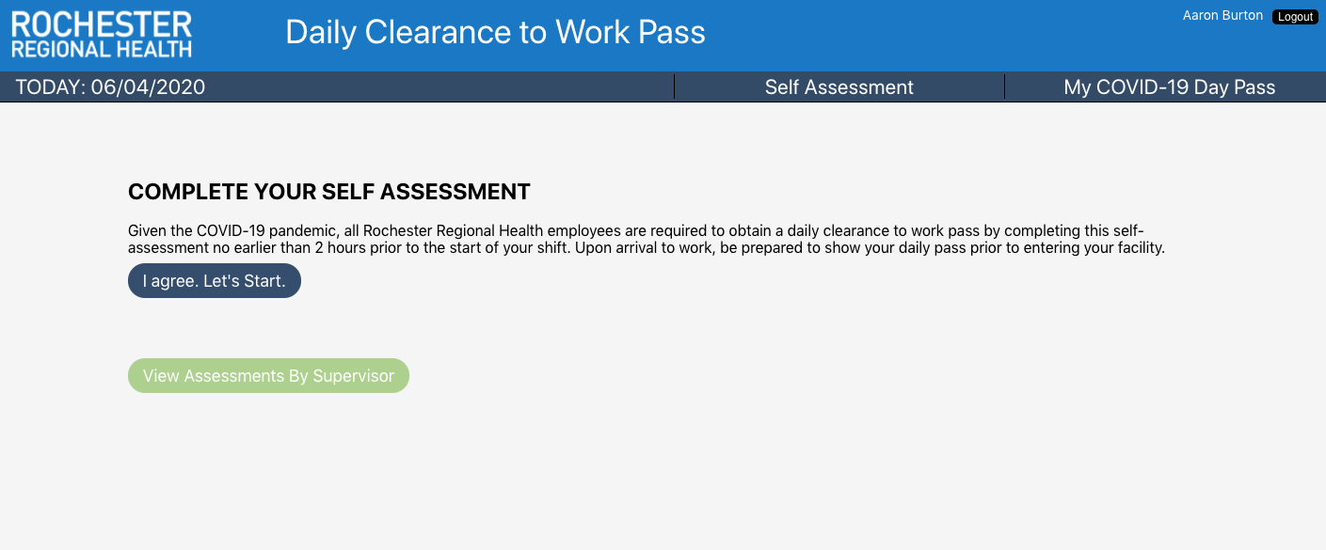
RRH DAILY REPORT GUIDE
HOW TO GENERATE A REPORT
The report will allow managers to generate a status report of employees that directly report to them.
When a manager logs into the Daily Pass – they will see a second button called – Employee Report
STEP 1: Click on Employee Report
View Employee Report
New button that will only appear for manager that have employees who report directly to them.

Slide 7
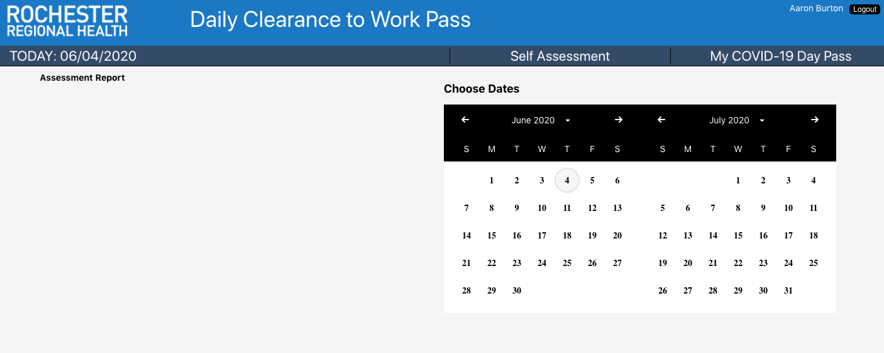
RRH DAILY REPORT GUIDE
HOW TO GENERATE A REPORT
STEP 2: Click Pick Start End Date
STEP 3:
Select Date or Date Range
Shows Date Range
For Report
STEP 4: Click on Fetch Report

Slide 8
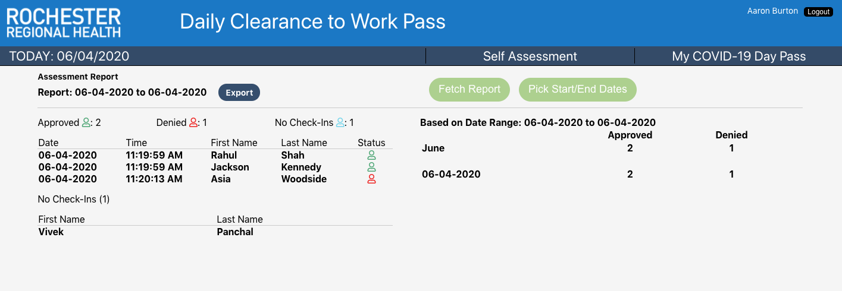
RRH DAILY REPORT GUIDE
HOW TO GENERATE A REPORT
Report
Date Range
Status – Approved, Denied, and No Check-ins
Date, Time, First and Last name of employee
Summary
Export Report in CSV file.

Slide 9
QUESTIONS
Q: What devices can I use to access and login to RRHDAILYPASS.org?
A: It designed to be used on iPhone and Android mobile phones. It will also work in Chrome, Firefox, Edge, and IE 11 desktop / laptop computer browsers.
Q: I tried to login, and got an error message?
A: This could have been caused because of a delay authenticating your credentials with the application. If this happens, refresh your browsers, and login again. To login - use your care connect username and password.
Q: I completed self-assessment and click submit, but nothing happened?
A: This could happen if you lost connection or had a very weak internet connection. If that happens, the application will save your answers. Check connection and refresh. Click on My COVID-19 Day Pass to retrieve your pass.
Q: If I need support who do I contact?
A: Please contact us by using our one of our Standard Service Desk methods:
Phone: 585-922-4357 Email: itservice@rochesterregional.org
MyIT - https://intranet.rochesterregional.org/istsupport/Pages/Home.aspx

